Slide 1
Weight loss tips
Name : KUL deep VARMA Reg. no. : 12110095
Roll no : k21sta16 Section : k21st
SUBMITTED BY : KUL DEEP VARMA SUBMITTED TO : ANKITA WADHAWAN

Slide 2
Description of work of project
This webpage I have created to help that people who wants to loss their weight to live a happy life. I have provided much details, tips, and exercises too to make this page sensible.
Kul Deep Varma
HTML : Code for Home.
CSS : Design for Home.
Link of project : https://kuldeepvarma7413.github.io/Weight-loss-tips/

Slide 3
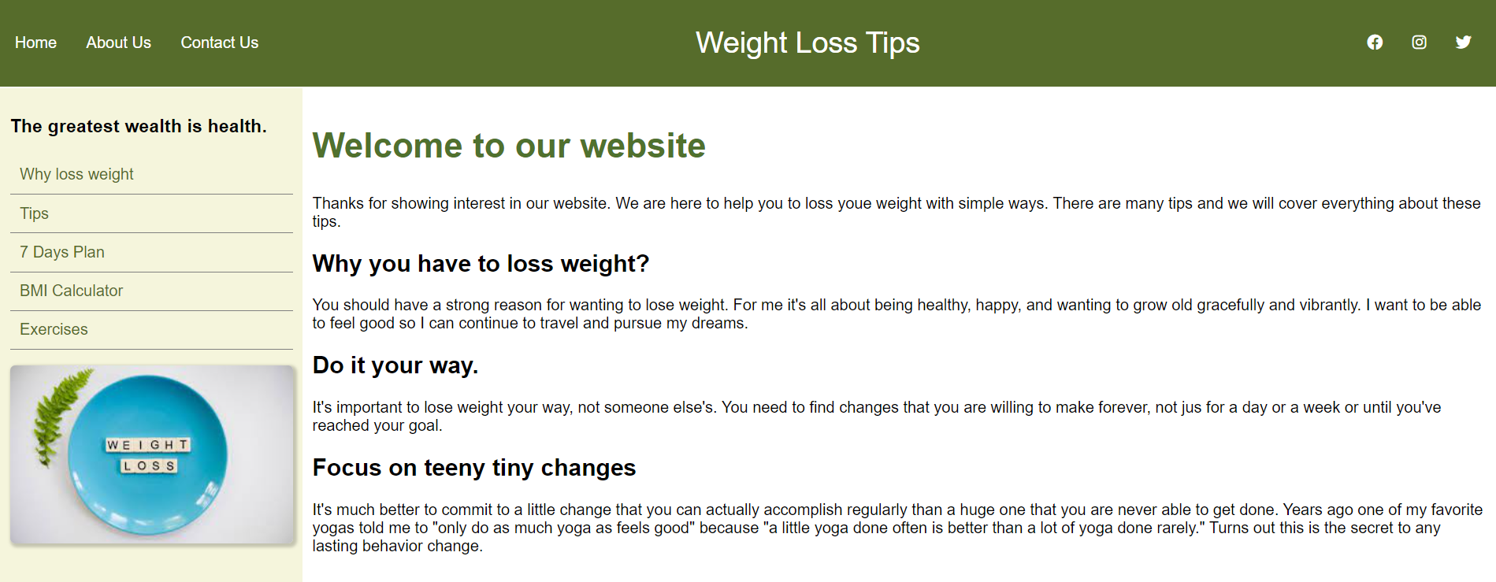
Welcome 1. It is welcome part of mine page. 2. Form here you can go to any specific part of page that is mentioned in left side bar. When you click on any option (provided) then it will take you out to that particular location. In the right side of header, social icons are provided. If you wants to connect with me then you can go for these social icons. 3. Tags used – html, body, header, div, section, aside, p, h2, img, h3, a, ul, li.

Slide 4
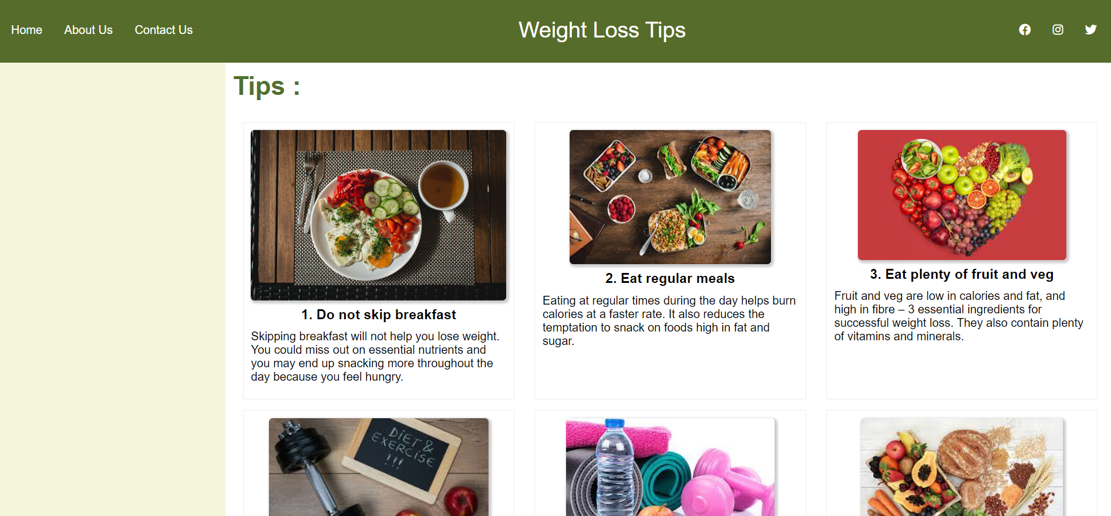
Tips 1. This is tips part of this webpage. 2. From here you will be able to know which procedure you have to follow during diet. I have explained about every diet in brief but you will be able to understand. I have attached images also to make you understand about points clear. 3. Tags used – html, body, div, h2, img, h3, p.

Slide 5
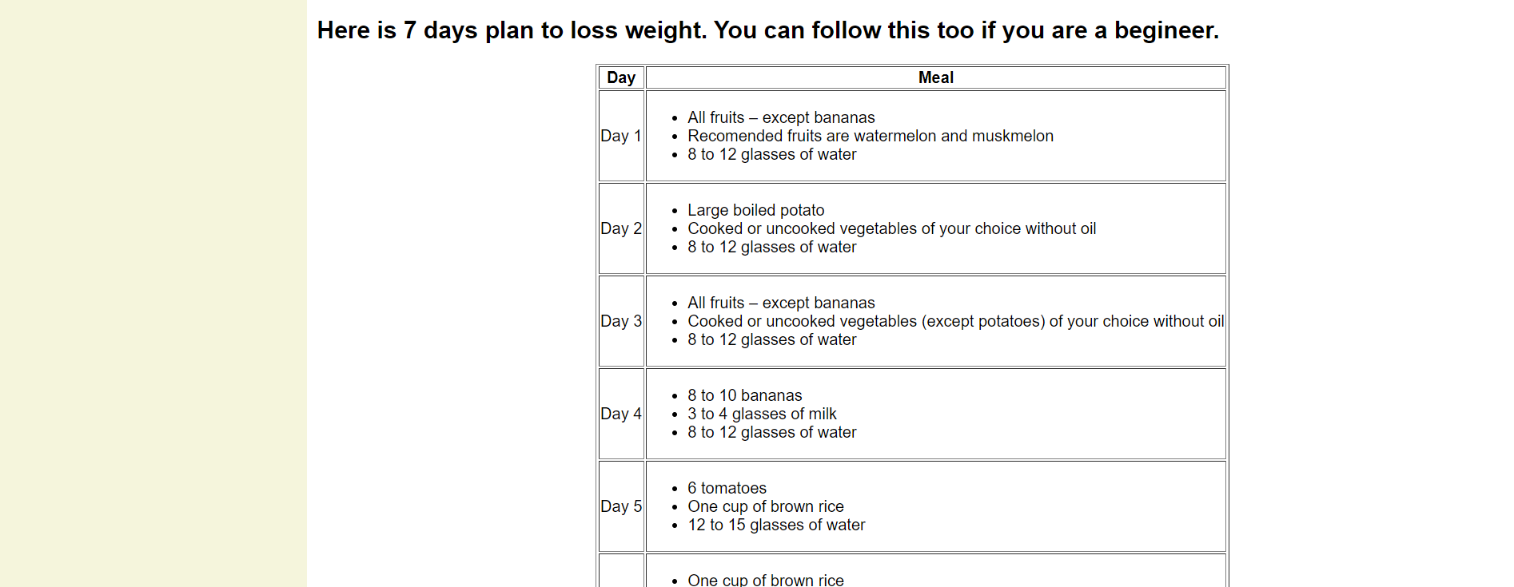
Diet plan 1. this is 7 days diet plan part of this page. 2. from here you will be able to know which day which plan you have to prefer for beginner. In first column I have written days of a week and in second column there are plans for the whole day. 3. Tags used – html, body, h3, table, thead, tbody, th, tr, td, ul, li, p.

Slide 6
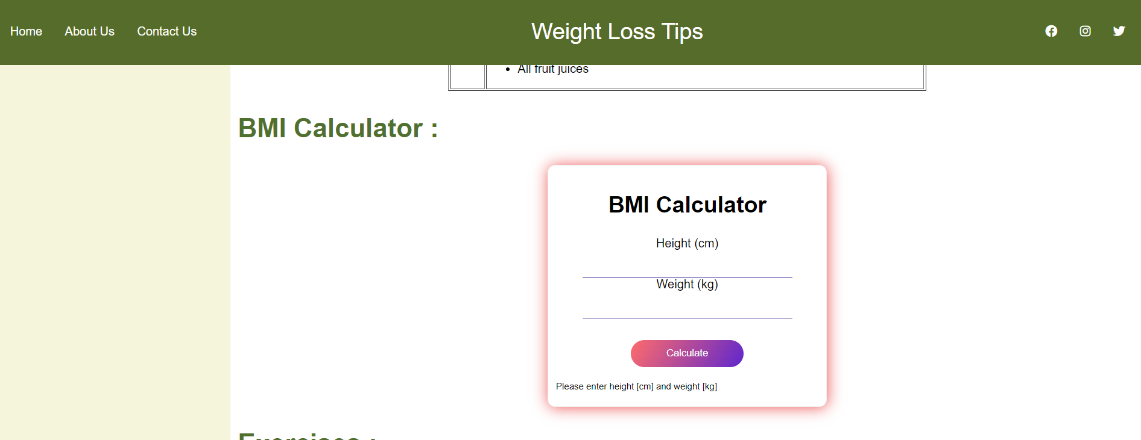
BMI CALCULATOR 1. this is BMI calculator part of this page. 2. from here you will be able to know about your BMI. Simply you have to give input of height in centimetres and same for weight in kilogram. After it simply you have to click ion calculate and your BMI will be visible above the button. 3. Tags used – html, body, div, h2, h3, p, input, button.

Slide 7
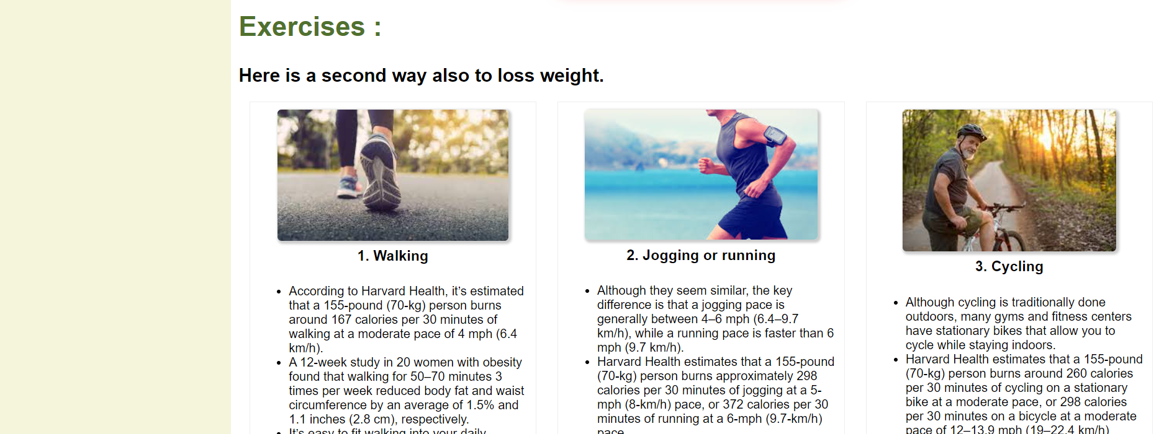
exercises 1. this is exercises part of this page. 2. from here you will be able to know about which exercise you have to do for weight loss. I have provided many tipes of exercises with details and past records related to it. By reading the all points you will learn right way of performing these. 3. Tags used – html, body, h2, h3, div, p, img.

Slide 8
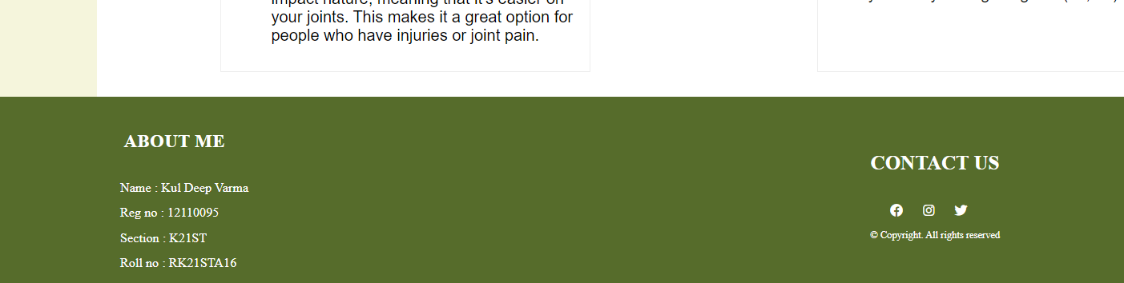
About and contact 1. this is about me and contact me part of this page. 2. from here you will be able to know about me and you will find many ways to reach me. In the left side of footer, there is my information and in right side, there are icons to reach me that I have already provided in header as well. 3. Tags used – html, body, footer, div, h2, p, ul, li.

